Slide 1
Zero Trust Architectures at Scale
Implementing Identity-Aware Proxies and Beyond on GCP
Cloud Chennai

Slide 2

Chapter One
Context

Slide 3

Why Zero Trust, Why Now
Remote work, Cloud adoption, BYOD
Breaches often start with stolen credentials or lateral movement
Traditional VPNs and firewalls are not enough
Regulatory drivers (e.g., NIST 800-207, CISA, PCI DSS 4.0)

Slide 4


Perimeter-based security is obsolete. Identity is the new perimeter

Slide 5
Learnings:
Average cost of a breach in 2024: $4.45M (IBM Cost of Data Breach Report)
80%
Breaches involve stolen or weak credentials (Verizon DBIR 2024)
60%
Employees now work outside traditional corporate networks (Gartner)

Slide 6
Scenario:
A developer accesses a Jenkins server from a personal laptop on public Wi-Fi. The session can be hijacked.
With Zero Trust
In Zero Trust, access would’ve required device trust + identity + secure tunnel (e.g., IAP).

Slide 7
Chapter Two
Foundations of Zero Trust

Slide 8
Core Zero Trust Principles
Never trust, always verify
Always assume breach
Verify explicitly
Least privilege access
Continuous monitoring & telemetry

Slide 9
GCP Native Zero Trust Building Blocks
Identity-Aware Proxy (IAP)
VPC Service Controls (VPC-SC)
Context-Aware Access
BeyondCorp Enterprise
Cloud Armor, SCC, Access Context Manager

Slide 10
Chapter Three
Core Implementation on GCP

Slide 11
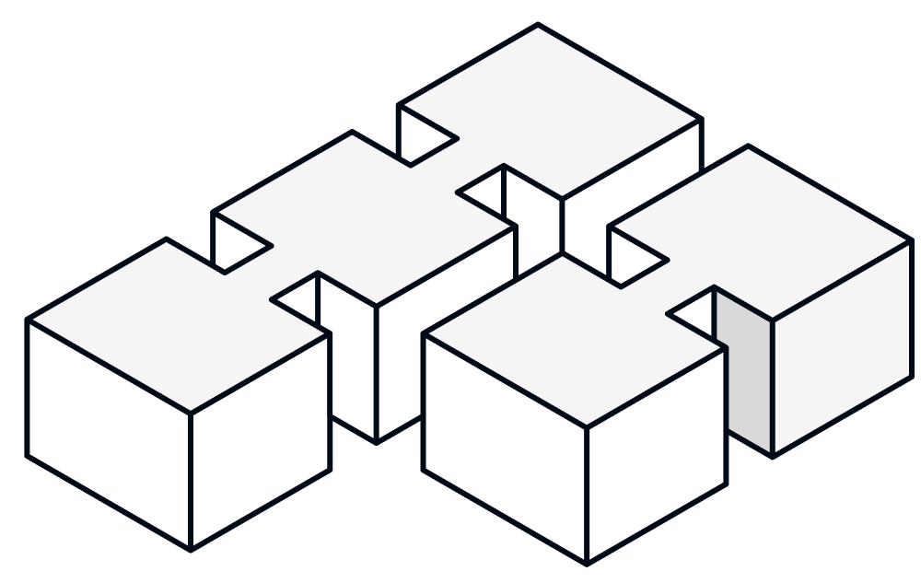
Identity-Aware Proxy (IAP)
A reverse proxy that enforces identity and access context
Features:
Integrates with OAuth2, Google Groups, IAM
No VPN needed; fine-grained access control
Logs every access attempt (Cloud Audit Logs)
Use Cases:
Internal web apps
Admin dashboards
Securing GKE and Cloud Run

Slide 12
VPC Service Controls
Mitigate data exfiltration from GCP services
How it works:
Define service perimeters
Restrict data movement across projects or networks
Use Cases:
Restrict access to BigQuery or GCS only from managed networks
Protect sensitive datasets from access via stolen credentials

Slide 13
Context-Aware Access (CAA)
Policies :
Identity & device posture
IP address / region
Session status (SSO, MFA)
Examples:
Allow access only from Chrome OS devices
Block access to DevOps tools outside business hours

Slide 14
Chapter Four
Real-World Deployment

Slide 15
Real-World Architecture on GCP
Frontend: HTTPS Load Balancer + IAP
Backend: Cloud Run / GKE microservices
Security:
IAM policies with context-aware access
VPC-SC perimeter for data layers
Cloud Armor for threat mitigation
Cloud Audit Logs + SCC for detection

Slide 16
Scaling Zero Trust at the Enterprise Level
Start small: Secure a single app with IAP
Define access levels: Role-based + context-aware policies
Monitor continuously: Use SCC, logging, anomaly detection
Expand perimeters: Use VPC-SC to isolate sensitive services
Integrate SIEM/SOAR: For automated threat detection & response

Slide 17
Chapter Five
Challenges & Expansion

Slide 18
Common Pitfalls & Recommendations
Pitfall | Recommendation
Over-relying on IP allowlists | Use identity + context instead
Inconsistent IAM policies | Use centralized policy management
Ignoring device posture | Leverage CAA for managed devices
No visibility after rollout | Enable logging + monitoring early

Slide 19
What’s Beyond IAP?
BeyondCorp Enterprise: Full Zero Trust SaaS from Google
Chrome Enterprise + Device Trust
Private Service Connect: Publish APIs privately across orgs
Workforce Identity Federation: Secure B2B without user provisioning
Anthos Service Mesh: Zero trust between services (mTLS + policy)

Slide 20
Chapter Six
Takeaways

Slide 21
Key Takeaways
Zero Trust is a journey, not a product
Identity-Aware Proxy (IAP) is a quick win
Combine VPC-SC, IAM, CAA for layered defense
Visibility and policy hygiene are critical
GCP provides scalable tools to implement Zero Trust in phases

Slide 22
Security is no longer about keeping everyone out—it’s about letting the right people in.

Slide 23
Thank You All
Cloud Chennai

